Slide 1
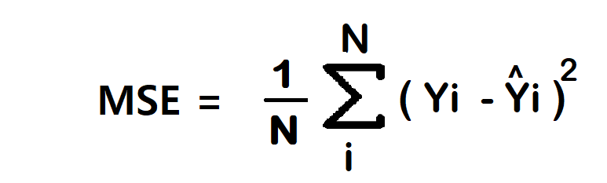
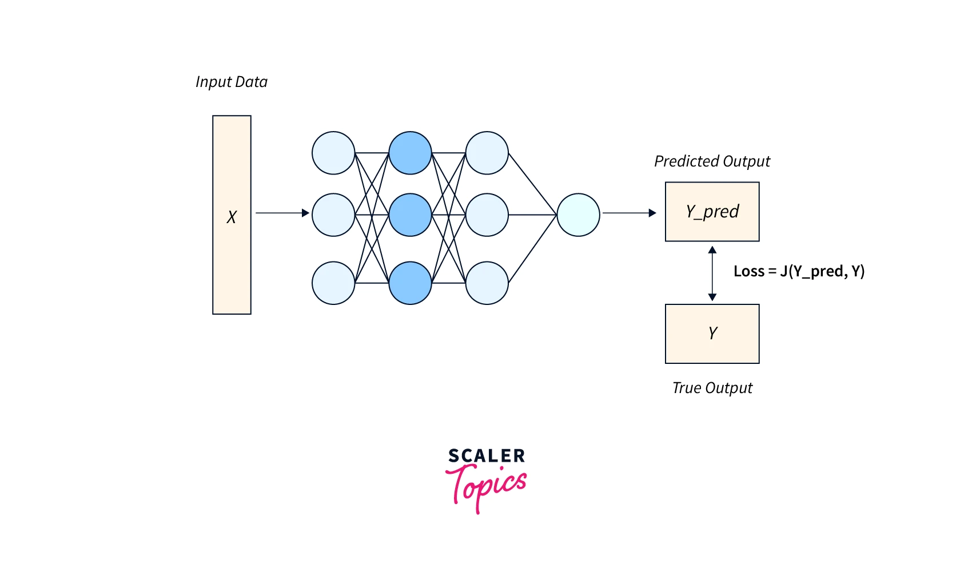
Loss Functions: Measuring the Error
A loss function quantifies how "wrong" the model's prediction is compared to the actual target.
Mean Squared Error (MSE): The standard for regression tasks (e.g., predicting house prices).
Categorical Cross-Entropy: The standard for classification tasks (e.g., identifying digits); it measures the distance between probability distributions.

Slide 2
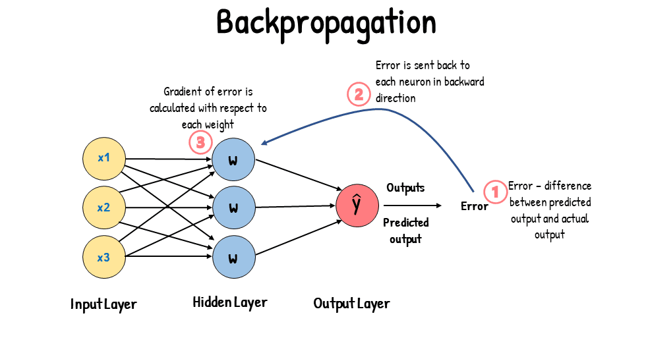
Backpropagation: Distributing the Blame
Once we have a loss value, we need to know how to change the weights to reduce it.
The Chain Rule from calculus is used to calculate the gradient of the loss with respect to every weight in the network.
It effectively allows the error to flow backward from the output layer to the input layer.

Slide 3
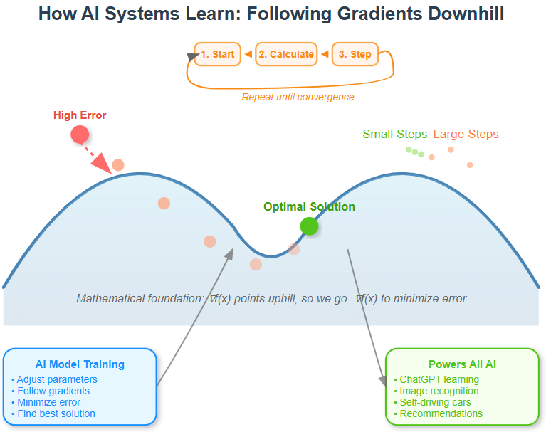

Gradient Descent: The Downhill Walk
We update weights by taking a small step in the opposite direction of the gradient.
Stochastic Gradient Descent (SGD): Updates weights using one sample (or a small batch) at a time.
Learning Rate ($η$): A crucial hyperparameter that determines the size of the step; too big and you overshoot, too small and training takes forever.

Slide 4
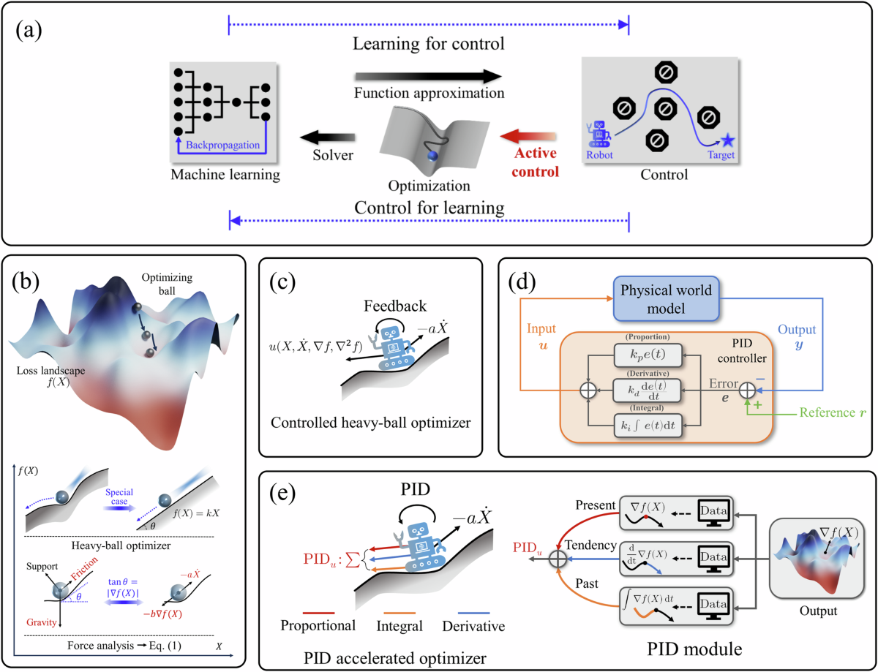
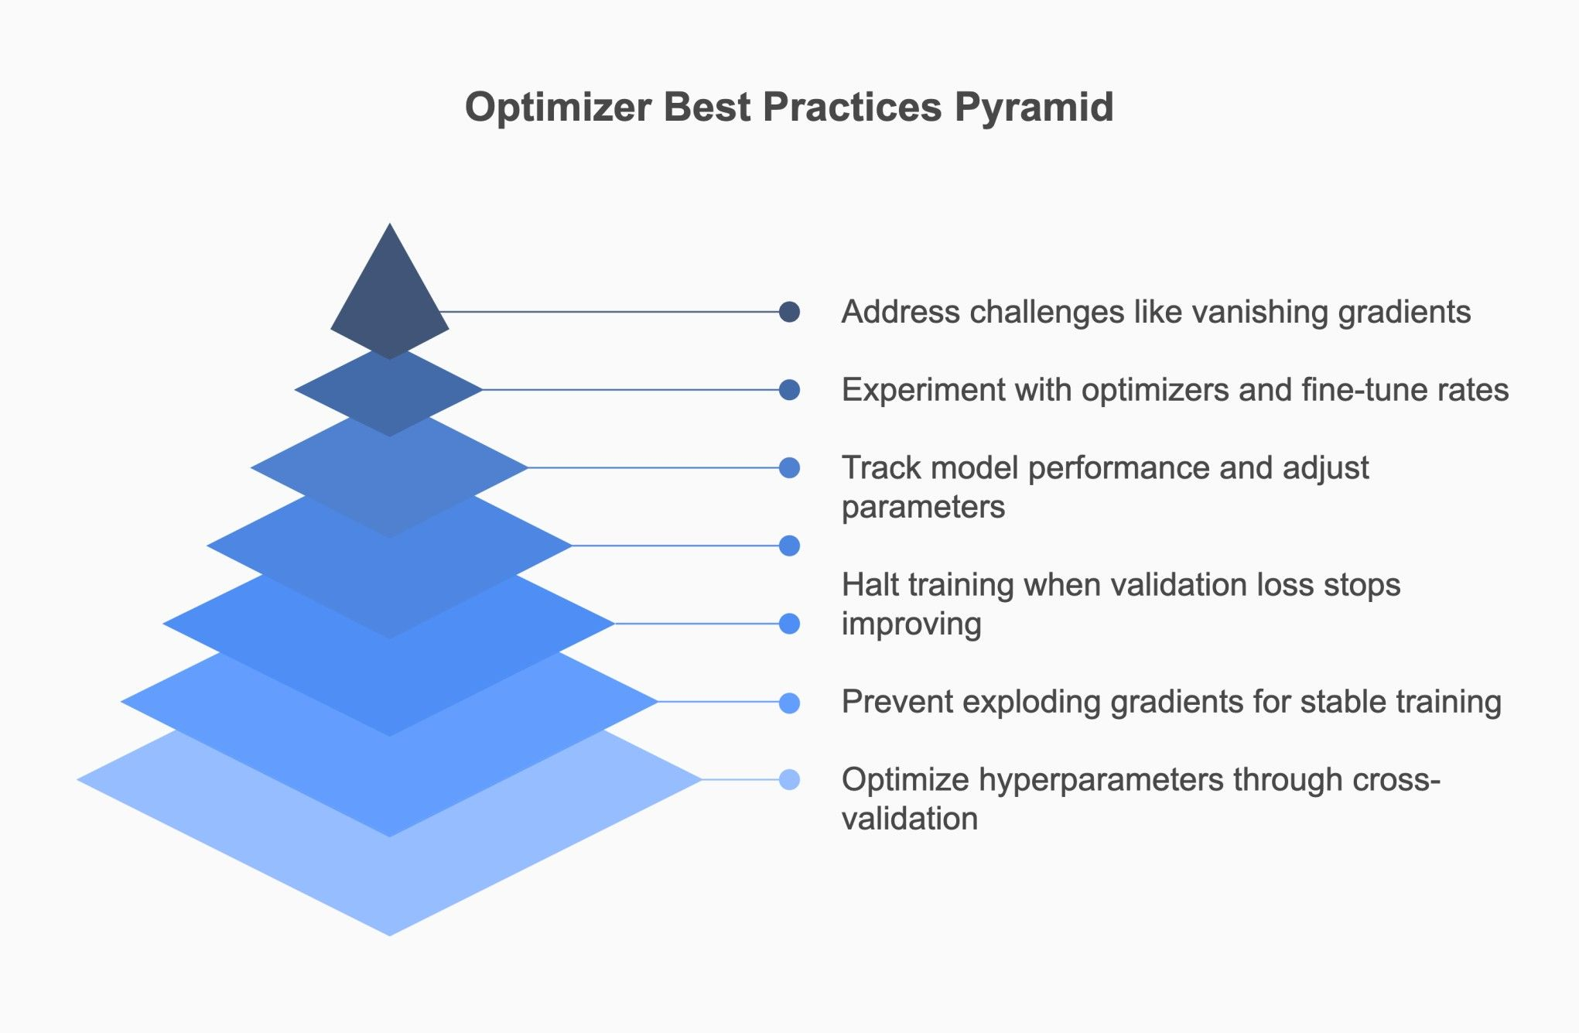
Advanced Optimizers: Speeding Up Convergence
Basic SGD can be slow or get stuck in local minima.
RMSProp: Adjusts the learning rate for each weight based on recent gradients.
Adam/AdamW: The "gold standard"; it combines the benefits of momentum and adaptive learning rates for faster, more stable training.

